Slide 1

Data Lake Exploration & Optimization Using Pyspark & Data Lake
- Ragavi Venugopal

Slide 2
Project Statement
Explore & optimize data stored in Azure Data Lake
Use Azure Databricks + PySparkSQL for querying & analysis
Enable data ingestion, transformation & visualization

Slide 3
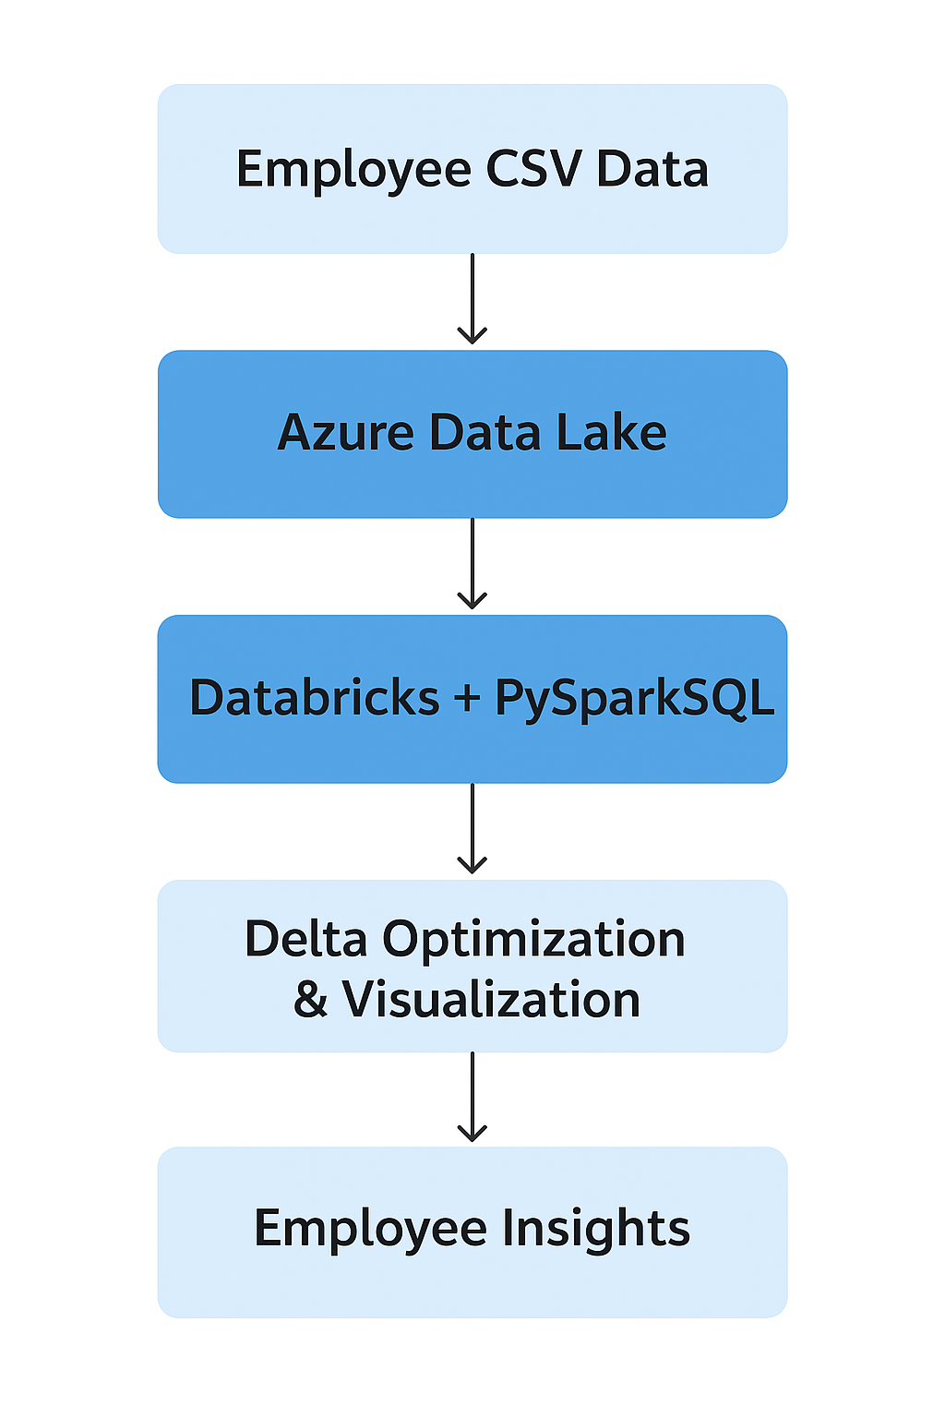
Flow Diagram

Slide 4
Project Overview
Built a data pipeline using Azure Data Lake and Databricks to ingest,
process (PySparkSQL), and optimize employee data in Delta format.
Enabled seamless data exploration and visualization in Databricks to
analyze salaries, department performance, and roles.

Slide 5
Project Objectives
Establish a secure connection between Azure Databricks and Data Lake to
efficiently query and analyze employee data.
Optimize CSV data into Delta format and use Databricks visualizations to
generate actionable employee insights.

Slide 6
Methodology
Prerequisites
Tools Used
Azure Subscription with credits
Azure Storage Account + Container
Azure Databricks Workspace & Cluster
Dataset: employees.csv
Azure Portal
Azure Databricks
PySparkSQL
Azure Storage Explorer (optional)
Databricks UI (for visualization)

Slide 7
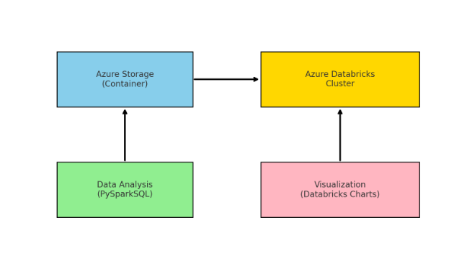
Architecture Diagram

Slide 8
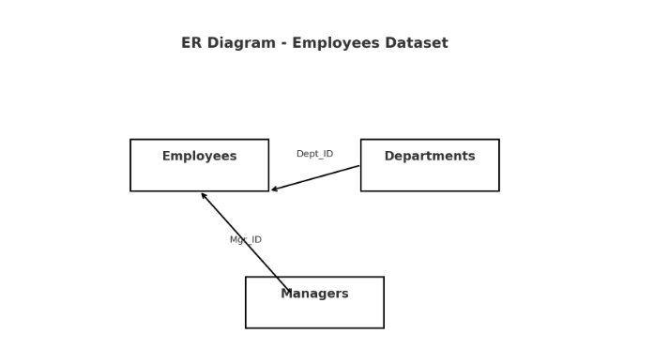
ER Diagram

Slide 9
Execution Overview
Source: The raw employee dataset is stored as a CSV file, which acts as the primary data source for analysis.
Storage: The dataset is uploaded into Azure Blob Storage inside the container named mycontainer for secure cloud storage.
Processing: Data is processed in Azure Databricks using PySparkSQL, allowing large-scale querying, filtering, and aggregation.
Optimization: The raw CSV is converted into Delta Lake format, improving query speed, supporting ACID transactions, and enabling efficient incremental updates.
Visualization: Analytical results are presented through Databricks charts such as bar, pie, and line charts for better insights and decision-making.

Slide 10
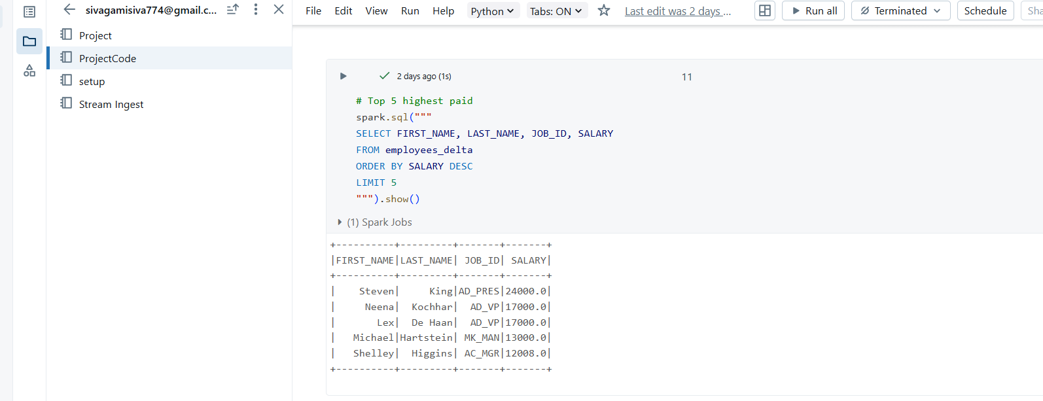
Analysis Results
1. Top 5 Highest Paid Employees

Slide 11
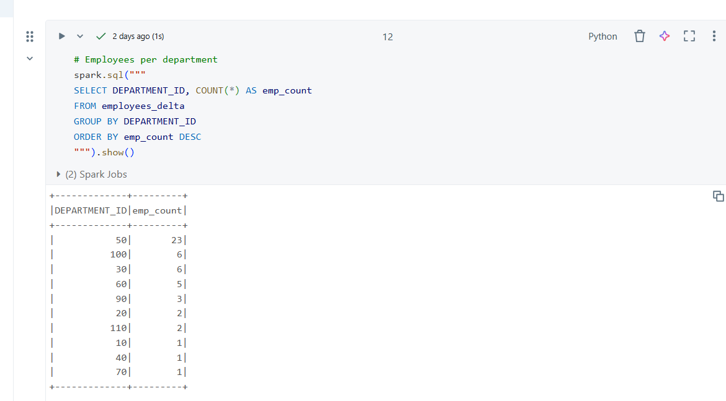
Analysis Results
2. Employees per Department

Slide 12
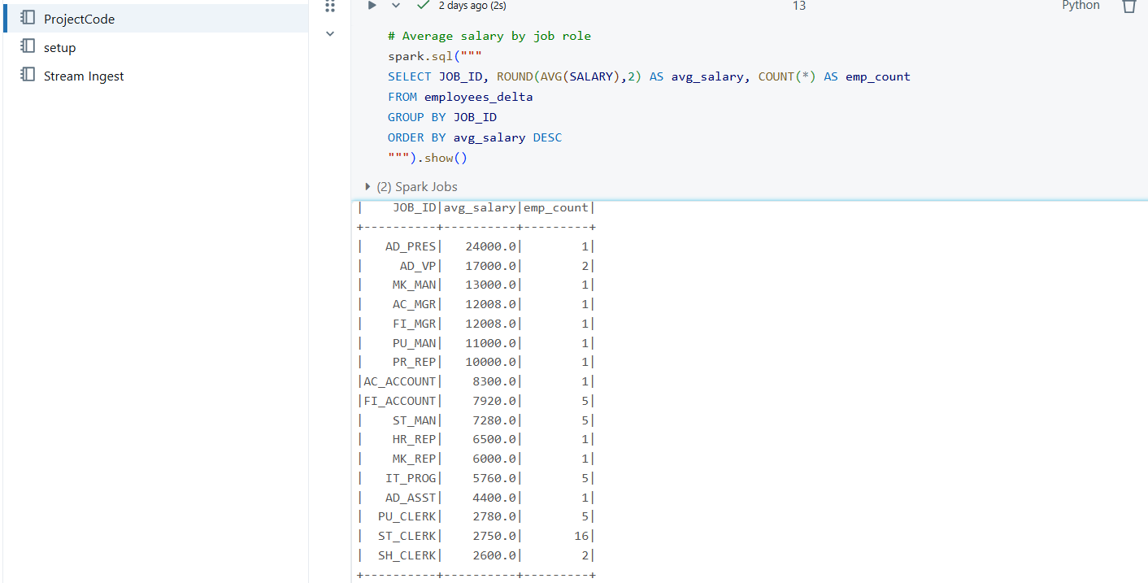
Analysis Results
3. Average Salary by Job Role

Slide 13
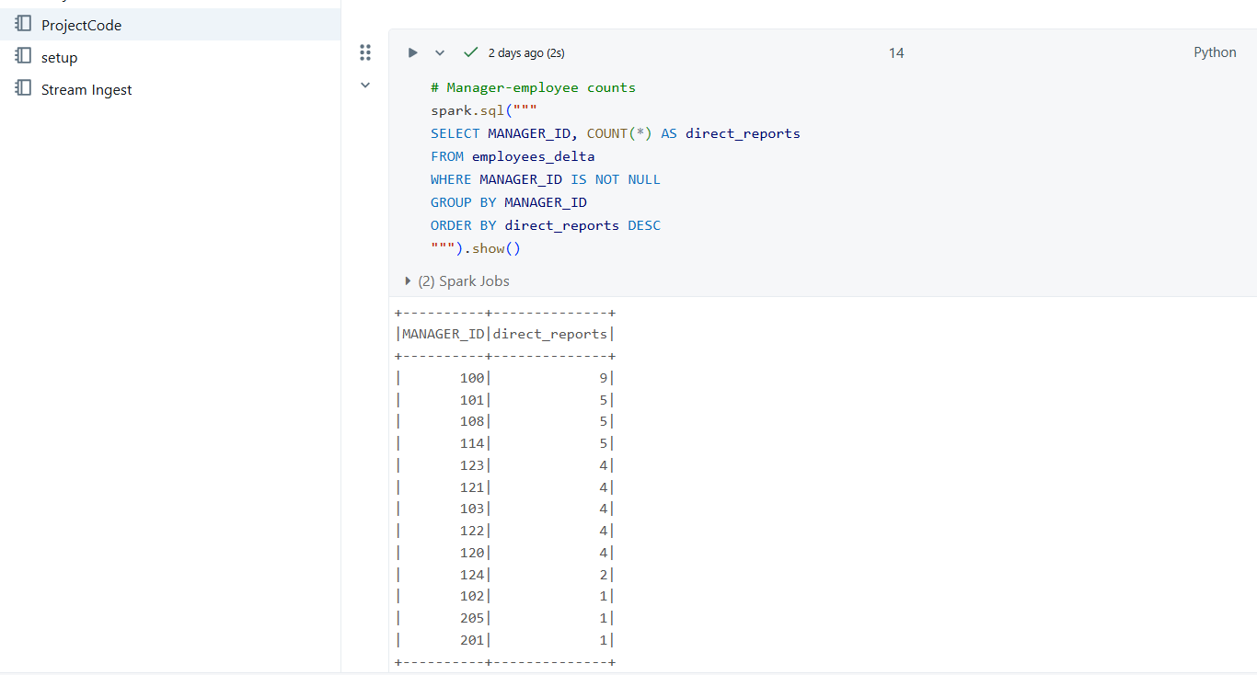
Analysis Results
4. Manager-Employee Counts

Slide 14
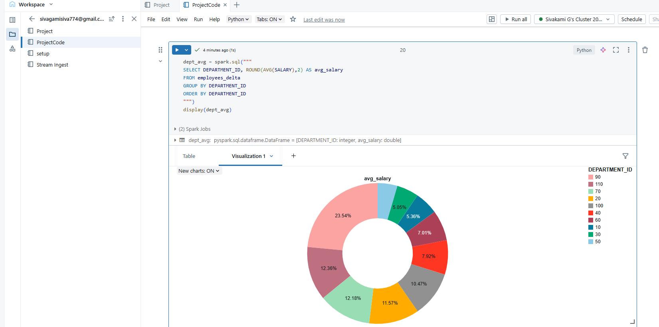
Successful Output Generated
Pie Chart Visulization

Slide 15
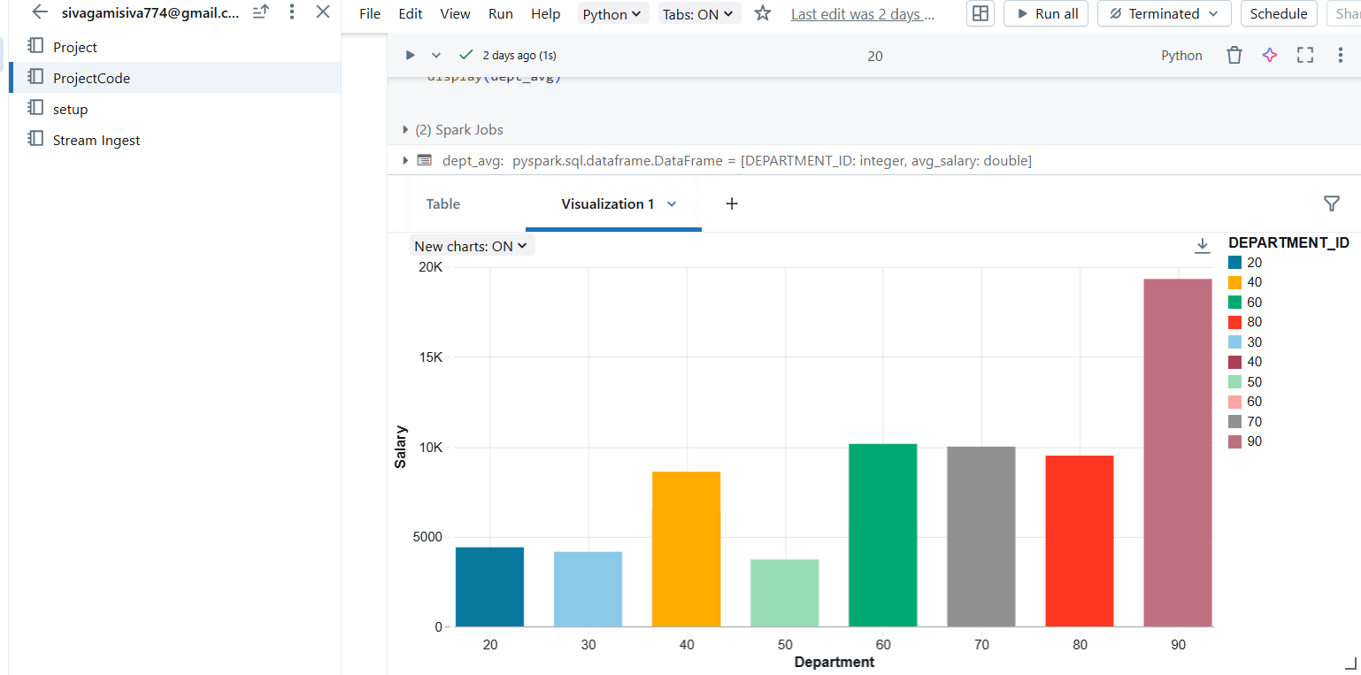
Bar Chart Visulization

Slide 16
Implementation Tasks Performed
Created Storage Account & container
Uploaded dataset
Created Databricks workspace & cluster
Mounted ADLS in Databricks
Ran SQL queries & analytics
Converted to Delta format
Built visualizations

Slide 17
Conclusion
Built end-to-end data analytics pipeline
Databricks + PySparkSQL enabled fast exploration
Delta format improved performance & reliability
Derived valuable insights & visualizations

Slide 18
Thank You

